Slide 1
EPQ Presentation
To What Extent is Time Travel Possible?
Tom Dodd

Slide 2
Main Points
The EPQ explores three main areas – the first two are closely related:
The different forms of time travel that exist
The theoretical and logical limitations of time travel

Slide 3
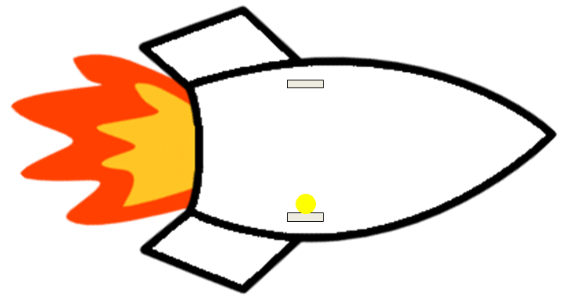

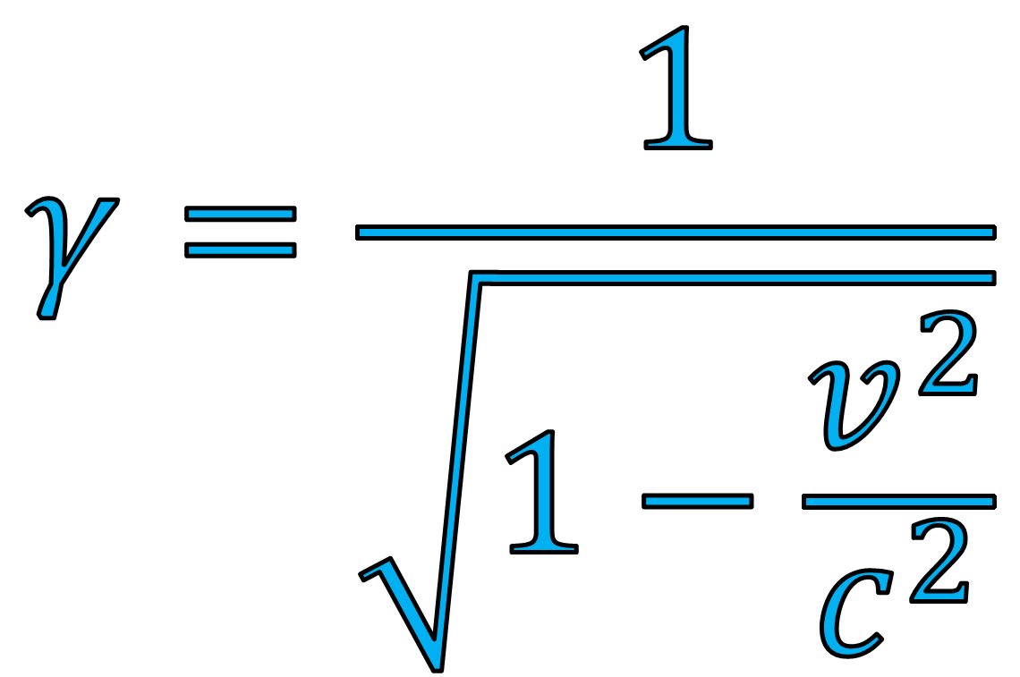
Special Relativity
$$Moving clock ticks slower, rocket contracts$$
$$Stationary clock ticks at normal speed$$

Slide 4

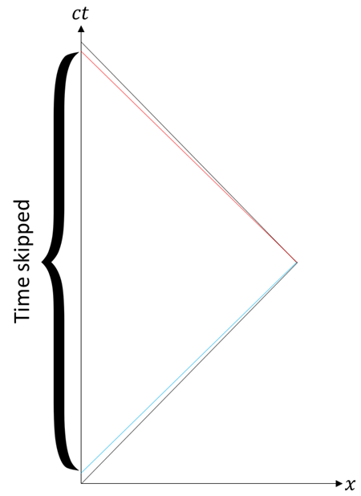

Forwards in Time
Space-time diagram
Older
Younger

Slide 5
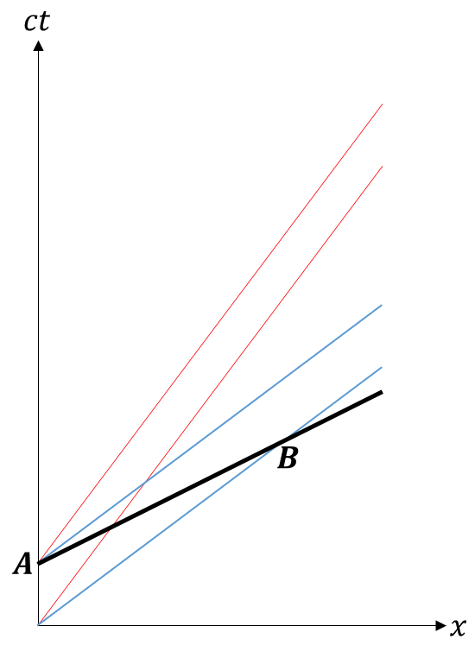

Tachyons
$$Imaginary Mass:$$
$$\sqrt{−1}$$
B: ct’=0
A: ct’=1

Slide 6
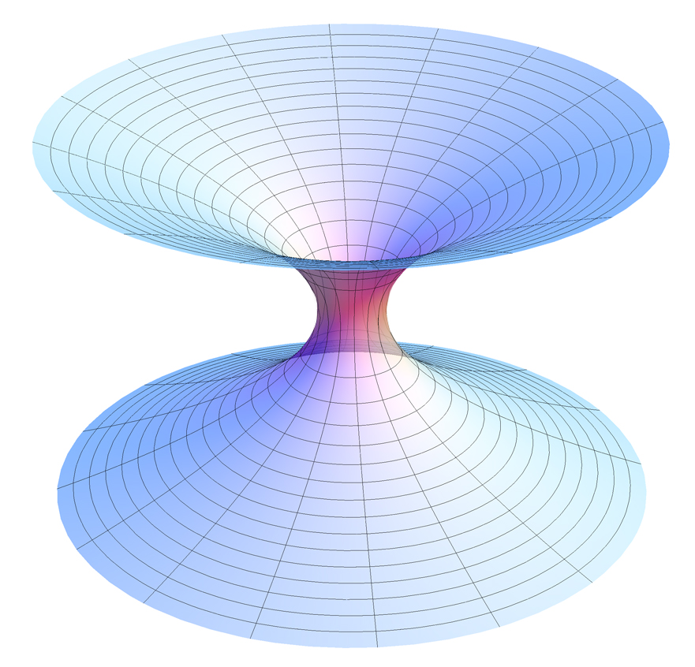
General Relativity
Wormholes

Slide 7
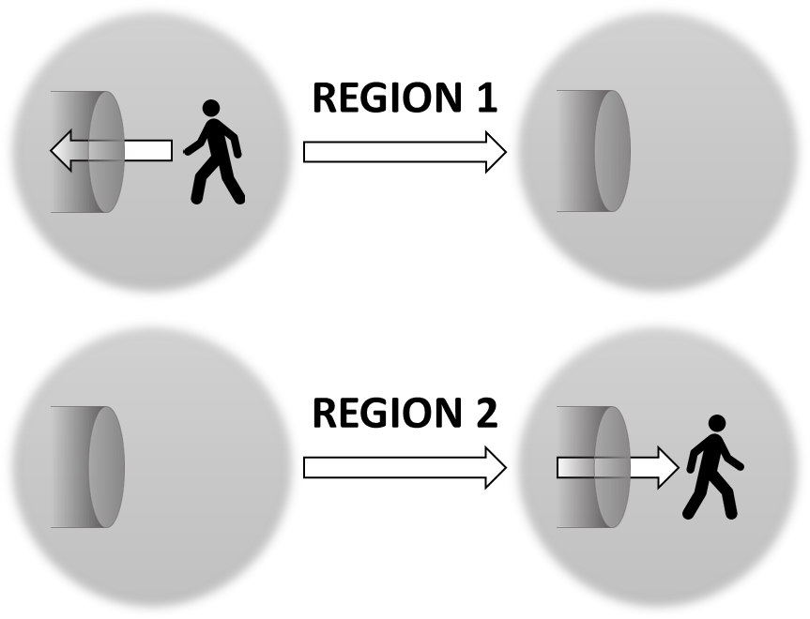


Wormholes
$$Enter here at one end of the universe…$$
$$Faster than light$$
$$Exit here at the other…$$

Slide 8
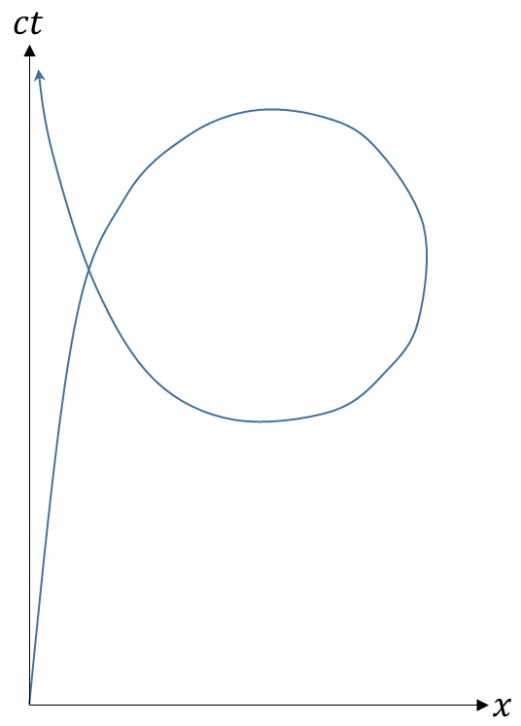
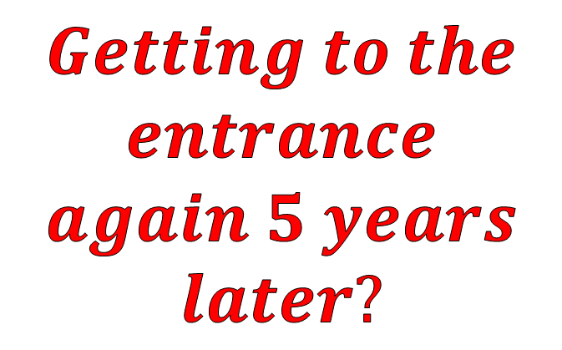


Paradoxes
$$Exit here in 2005…$$
$$Enter here in 2015…$$
$$Getting to the$$
$$entrance$$
$$again 5 years$$
$$later?$$
Closed
timelike
curves

Slide 9
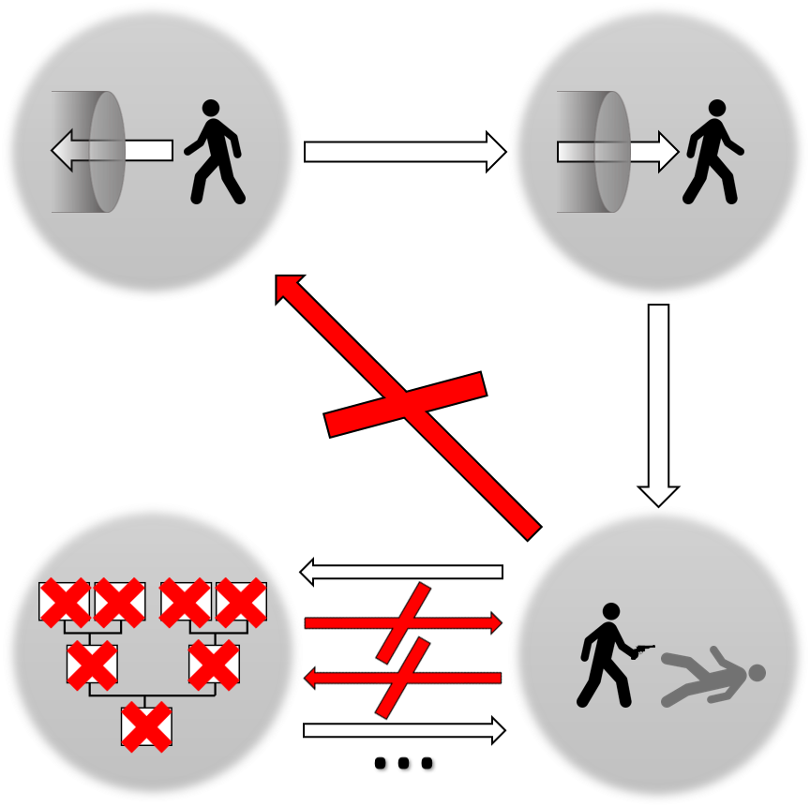
Grandfather Paradox
2015
1960
Killer
never born
Who killed
The grand-
father?
Grandfather
killed

Slide 10
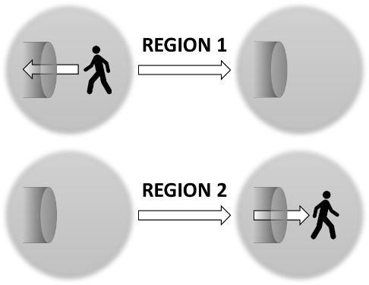

Multiverse
Universe 1 in 2015
Universe 2 that
looks like 2005

Slide 11

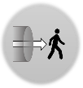


Tegmark Hierarchy
$$Observable Universe 1$$
$$Observable Universe 2$$

Slide 12
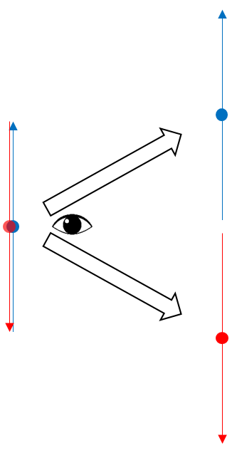
Multiverse of Quantum Mechanics
The wormhole
and quantum
mechanical
multiverses are
different

Slide 13
Main Points
The different forms of time travel that exist
The theoretical and logical limitations of time travel
The extent to which humanity can make use of the physics of time travel

Slide 14


The Dangers of Wormholes
?

Slide 15
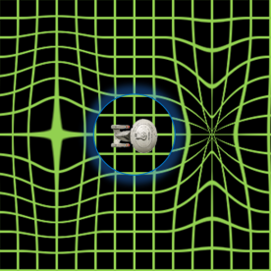
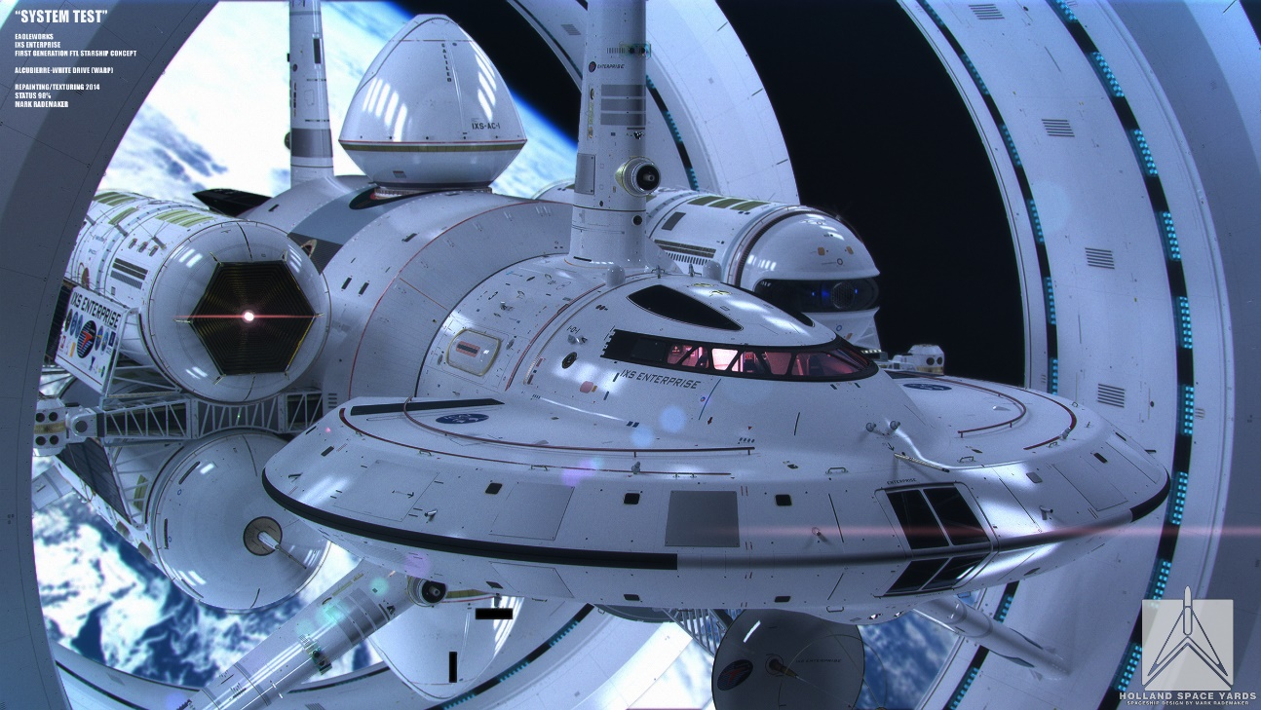
NASA’s warp drive
$$Drastically distorts spacetime to achieve$$
$$faster−than−light travel times$$

Slide 16
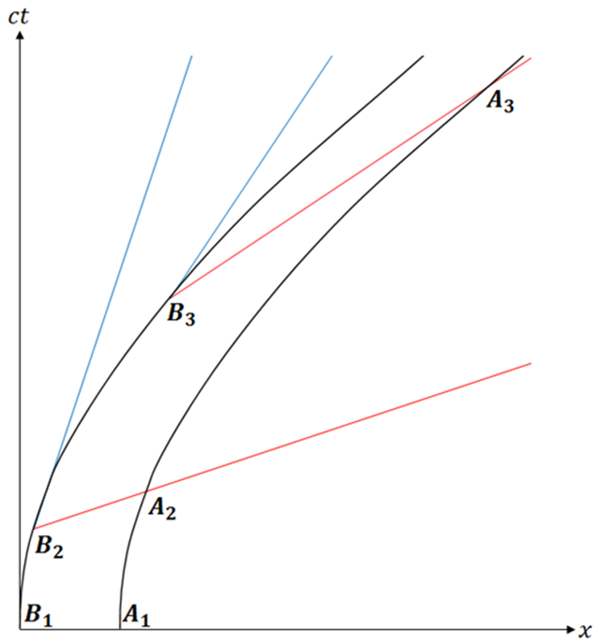

Problems with Acceleration
The front of the rocket
accelerates faster than
the back, leading to
the rocket being
stretched apart

Slide 17
Research
Most research achieved using the internet:
Scientific papers
Lectures
Some equations and calculations were made:
Relativistic acceleration
Fuel requirements for time travel in reality

Slide 18
Research
Most papers from more well-known physicists agreed with each other
Papers related to Special Relativity easier to comprehend, while some papers were very difficult to understand
The research related to the reality and requirements of time travel revealed many difficulties with the activity

Slide 19
Strengths and Achievements
The final written report contained a wider variety of information than first thought possible, due to the surprisingly large amount of research done by theorists
The topics discussed show the differences in theory, logic and reality

Slide 20
Weaknesses
A lot of the content of the report is highly theoretical and could be difficult to understand in places
Much of the physics discussed borders with quantum gravity – an area of physics very poorly understood at the moment

Slide 21
Conclusion
I have learned about areas of physics which I did not think I would be studying at this time
I have considered using what I have learned to conduct my own theoretical research
I have hugely enjoyed writing the EPQ report, and discussing my topic with others

Slide 22
Thank-You For Listening
Picture sources:
Rocket: Clipart Panda
Wormhole: AllenMcC
IXS Enterprise: Mark Rademaker
Warp drive diagram: Mark Rademaker

